Slide 1
Campaign Overview & Objective
Title: Feedback Campaign Performance & Need for OTP Verification Objective: To analyze the initial feedback campaign performance and highlight the importance of verified data collection via OTP.

Slide 2
Test Campaign Snapshot
Campaign Name: Feedback Date: April 23, 2025 Audience Size: 1031 Users Message Type: Text Template (Broadcast) Credit Used: ₹591.36 Performance Metrics: - Sent: 1031 (100%) - Delivered: 672 (66%) - Read: 546 (53%) - Replied: 0 (0%) - Failed: 356 (35%) (Refer to image for visual representation)

Slide 3
Key Challenge - Data Accuracy
- Sales team collecting data without verification - Leads to inaccurate entries & unusable feedback - Difficult to derive actionable insights Solution: OTP verification ensures: - Data integrity - Valid mobile numbers - Authentic transactions

Slide 4
Special Cases - AIIMS & Govt. Institutions
Challenges: - Faculty reluctant to share numbers or be photographed Approach: - Open to collaborative alternative solutions - Custom processes may be implemented with cooperation

Slide 5
Security Assurance on OTP Sharing
- OTP sharing is standard industry practice - Used across Amazon, Flipkart, Swiggy, Zomato etc. - Ensures secure confirmation and accountability Note: OTP never misused; solely for verification

Slide 6
Long-Term Proposal & Interim Recommendation
Immediate Requirement: - Mandatory OTP verification to ensure data quality

Slide 7
Conclusion & Way Forward
- Current bounce rate ~35-40% due to unverified data - Implementation of OTP will enhance delivery & feedback - Let’s collaborate to find flexible models for difficult institutions Next Steps: - Schedule meeting to finalize verification protocol - Collect input for special cases handling

Slide 8
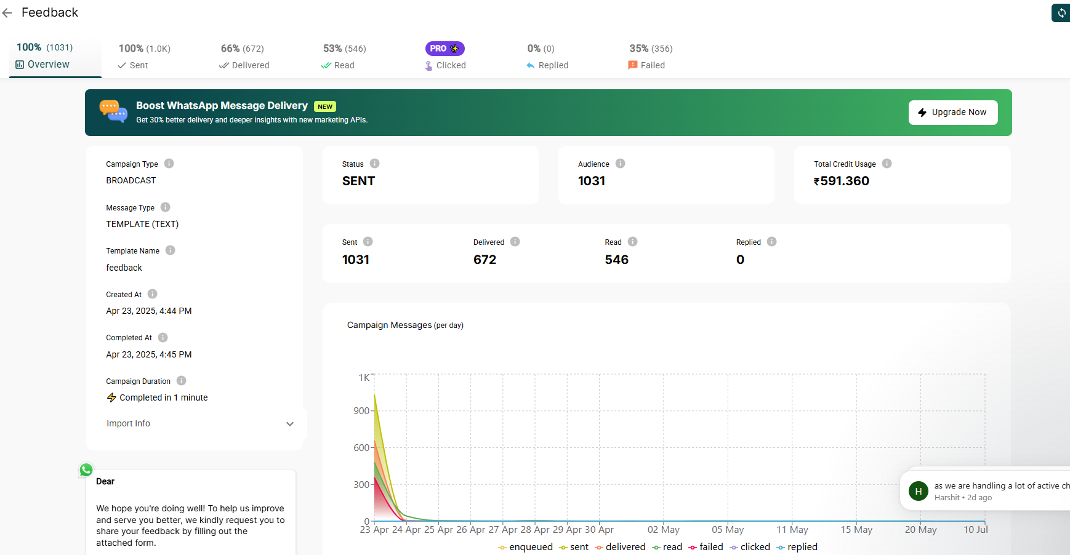
Visual Representation - Campaign Performance

